Slide 1
Presbyterian Disaster Assistance
PDA
Notes:
Good morning, Presbyterian Disaster Assistance, or PDA as we call it, is one of most celebrated and effective programs of the Presbyterian Church. It is one of 8 programs of the PMA’s Compassion, Peace and Justice Division supported by your Per Capita and Shared Mission Giving, and is one of the ministries supported by the OGHS offering received during Lent. PDA responds in three areas.

Slide 2
International Response
http://pda.pcusa.org/situations/international/
Notes:
Internationally, Nationally and Special projects. You can see here a screen shot of PDA’s website and some of the international responses where we are working.

Slide 3
National Response
http://pda.pcusa.org/situations/national/
Notes:
Nationally, PDA is active in these states. They’ve been active in Michigan for the Flint Water Crisis.

Slide 4
National Responses
Notes:
As well as these national crisis.

Slide 5
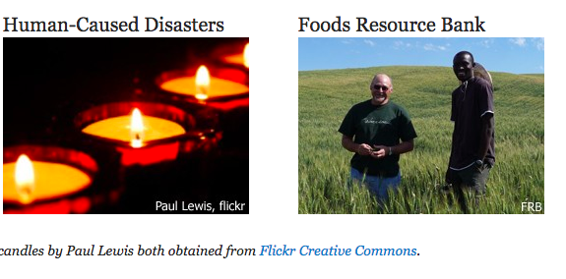
Special Projects
Notes:
A third area of PDA work is in special projects. PDA held a Disaster Preparedness Training for us at Battle Creek last summer sponsored by our PW. Every congregation and presbytery needs to identify a point person or team to prepare. After 9/11 PDA held a Retreat for first responders and clergy at Stony Point Conf. Center for Emotional / Spiritual Care. Cully Culpepper, a member of our presbytery is a PDA volunteer who gets assigned to congregations who have experienced the trauma of sexual misconduct by a congregational leader.

Slide 6
In the aftermath of the Parkland, FL shooting
Notes:
Two days after the shooting at Marjory Stoneman Douglas High School in Parkland, PDA National Response Team (NRT) members trained in responding to public violence arrived in the Presbytery of Tropical Florida to provide a ministry of presence. The NRT members joined the Presbytery for a community vigil and lead a discussion afterwards for pastors and faith leaders to discuss ways to deal with this tragedy and learn about PDA resources that are available to them. On Sunday the NRT members worshipped at PC(USA) churches nearby and were given the opportunity to give Minute for Missions on the work of PDA and their reasons for being present.. PDA staff assembled liturgical reflections churches can use as a resource in the aftermath of this tragedy.
Trigger, the award-winning documentary produced by PDA, frames gun violence as a disaster and public health issue. It examines how one shooting impacts individuals, families and community.

Slide 7
FLOOD RESPONSE HERE
Notes:
Three weeks ago, we experienced flooding in our region. I requested Presbyterian Disaster Assistance. We were assigned Jan Spence, a PDA volunteer. She connected me with Michigan VOAD, a group which coordinates volunteer responses with helping agencies. MARCs (Multi Agency Response Cites) have been set up in affected cities where families may go to receive assistance. First Presbyterian in Niles is hosting a MARC Friday, Saturday and this Monday. The Presbytery of Lake Michigan has received an initial $7500 grant for hiring a response coordinator. Elder Tammy Stanton is filling that position in Niles.

Slide 8
Gift of the Heart Kits
Clean Buckets
Hygiene Kits
School Kits
http://pda.pcusa.org/page/act/
Notes:
PDA, VOAD, the Red Cross welcomes and trains volunteers. The Red Cross has provided the initial response and assessment. Clean up will be needed as the water receeds. PDA excels in our organization and staying power for long term recovery, setting up the infrastructure for hosting clean up teams. PDA also encourages congregations to get involved by preparing Gifts of the Heart Kits, coordinated with CWS. This web site provides assembly instructions. You can support any of these responses with a designated gift. But your OHGS gift empowers the church to respond immediately. Please give generously.

